Slide 1

Semantic Tableaux Method
Ciama Andreea Elena group 911

Slide 2
Theoretical result
A semantic tableaux is a binary tree associated to a formula U having formulas in its nodes and its nodes and is built as follows:
The root of the tree is labeled with the initial formula.
Every branch of the tree which contains a formula will be extended with a subtree according to the decomposition rule specific to its class
The extension of a branch stops in the following cases:
a) if that branch contains a formula and its negation, the branch is marked as closed using the symbol ⊗.
b) if all the formulas on that branch are already decomposed or if by decomposing the formulas which are not yet decomposed, no new formulas are obtained

Slide 3
A branch of a semantic tableau is called closed if it contains a formula and its negation, otherwise the branch is called open. A branch is called complete if it is closed or all the formulas on that branch are already decomposed. A semantic tableau is called closed if all its branches are closed If a semantic tableau has at least one open branch, the tableau is called open. A semantic tableau is called complete if all its branches are complete
Remarks: A closed branch symbolizes inconsistency among the formulas on that branch. An inconsistent formula has associated a closed semantic tableau. The set of formulas belonging to a complete and open branch is consistent, meaning it has a model. A consistent formula has associated a complete and open semantic tableau.

Slide 4
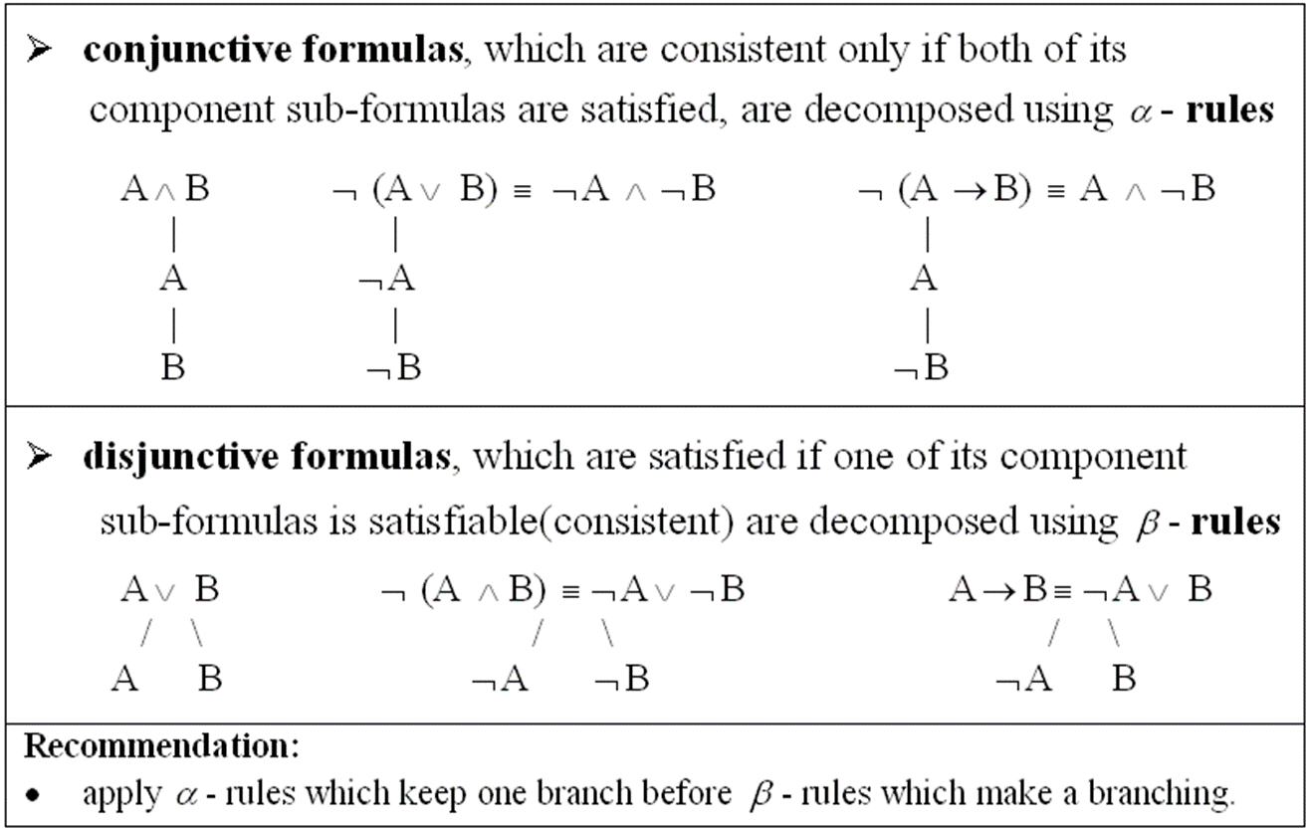
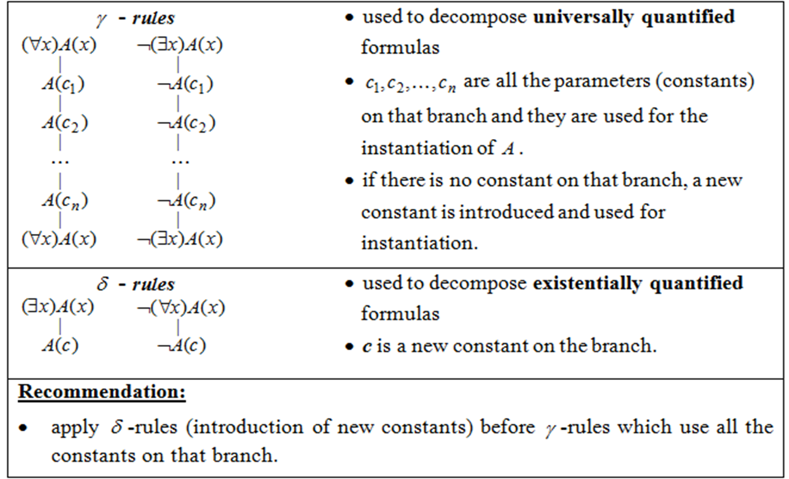
Decomposition rules

Slide 5
Exercise 6
Using the semantic tableaux method check whether the following logical consequences hold.
1. (∀x)(P(x) → Q(x)), (∀x)P(x) I = (∀x)Q(x);

Slide 6
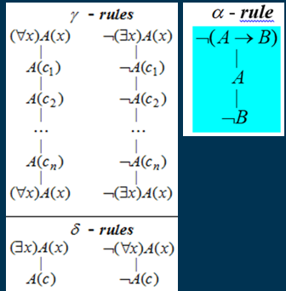
(∀x)(P(x) → Q(x)) ∧ (∀x)P(x) ∧ ¬ (∀x)Q(x) (1)
| α-rule for (1)
H1: (∀x)(P(x) → Q(x) (2)
|
H2: (∀x)P(x) (3)
|
¬C: (∃x) ¬ Q(x) (4)
| δ-rule for (4) –a new constant
¬ Q(a)
| γ-rule for (3) used for instatiation
P(a) (5)
|
(∀x)P(x) (copy of formula 3)
| γ-rule for (2)
P(a) → Q(a) (6)
|
(∀x)(P(x) → Q(x)
/ \ β rule for 6
¬P(a) Q(a)
⊗ closed branch ⊗ closed branch
H1,H2 |= C iff
H1 ∧ H2 ∧ ¬C has a closed semantic tableaux

Slide 7
Conclusion
In conclusion, due to the fact that all branches are closed, the logical consequence holds

